Slide 1
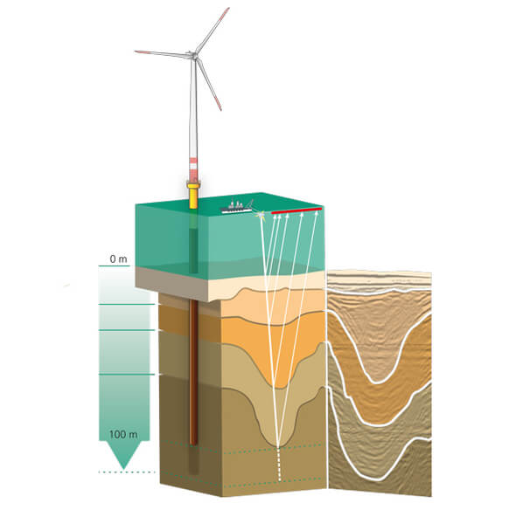
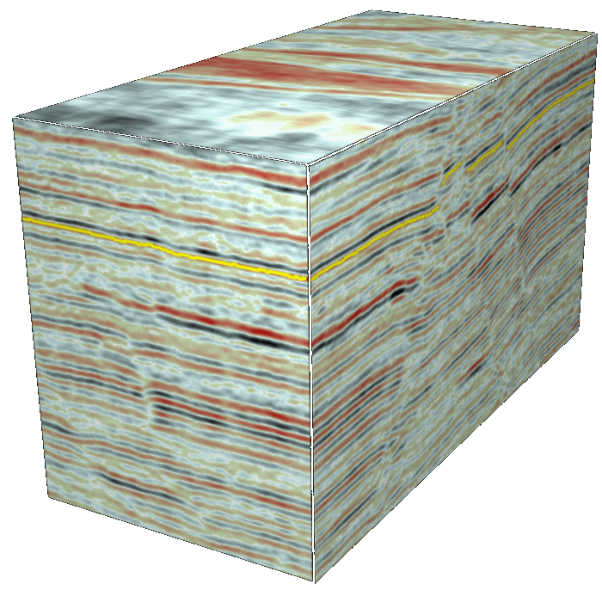
Seismic reflection data
Dr Rebecca (Becky) Bell and Raul Adriaensen
2nd floor, office 2.37a
rebecca.bell@imperial.ac.uk

Slide 2
Seismic reflection environmental applications
Offshore wind-turbine installation
Base piles often penetrate 60-80 m
below the seafloor
Need to understand geological
structure below the seafloor including:
- whether subsurface consists of
soft-sediment or hard-grounds
- whether methane gas poses drilling
hazard
- whether there are any fault zones
https://w3.windfair.net

Slide 3
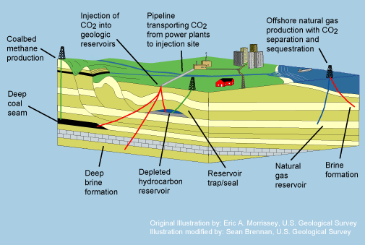
Seismic reflection environmental applications
CO₂ capture and storage
Require an understanding
of 3D subsurface structure at
km scale to:
- locate porous and impermeable units
- Locate faults which could be conduits or seals
Would like to be able to
image the injected CO₂ and
assess leakages over time
https://www.quintessa.org/co2fepdb/v2.0.0/

Slide 4
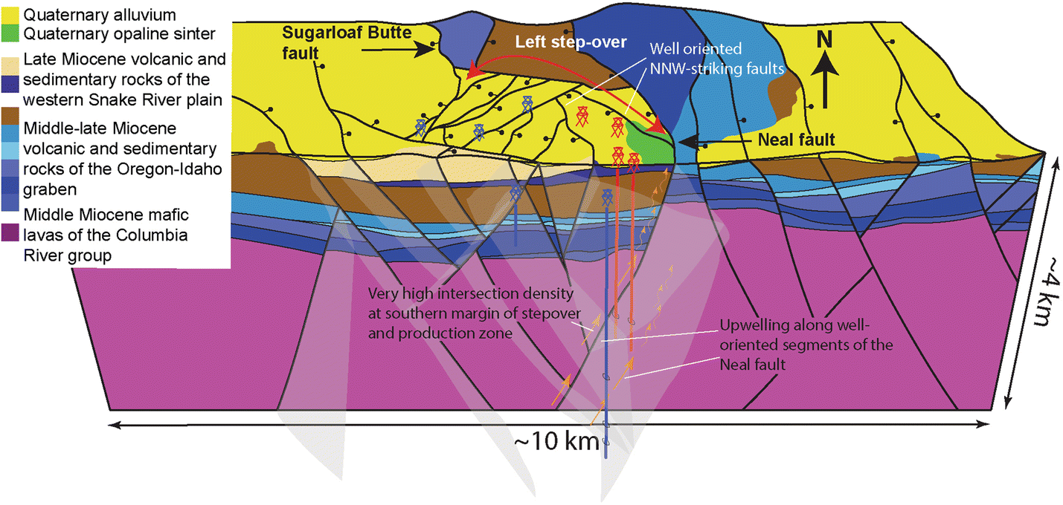
Seismic reflection environmental applications
Geothermal energy
Largest cost in geothermal projects is deep drilling
Seismic reflection data allows you to characterize the fault system so drilling can be targeted and more successful
Siler et al. 2019, Geothermal Energy

Slide 5
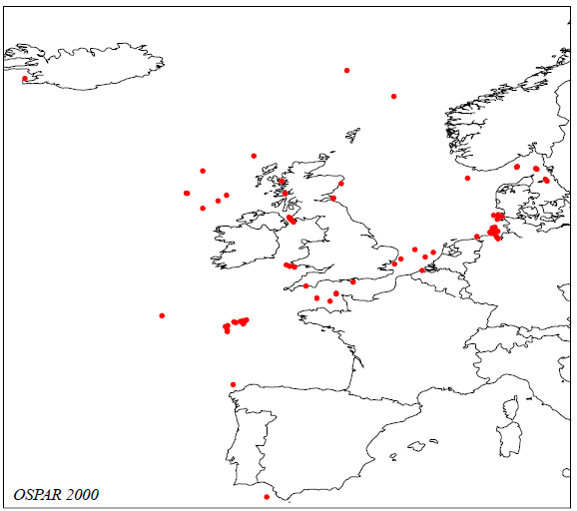
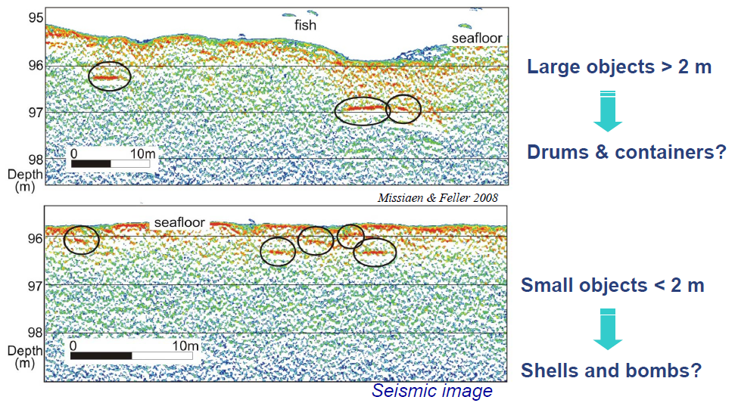
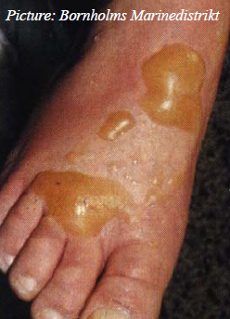
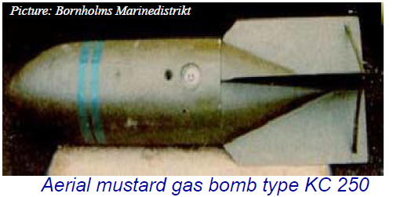
Seismic reflection environmental applications
Unexploded ordnance (UXO) and debris detection
Dr. Tine Missiaen
Missiaen and Feller 2008
After WW1 and WW2 large amounts of conventional and chemical weapons were dumped in European Seas
shells, mines, bombs, drums, containers, ships
Arsenic and mustard gas

Slide 6
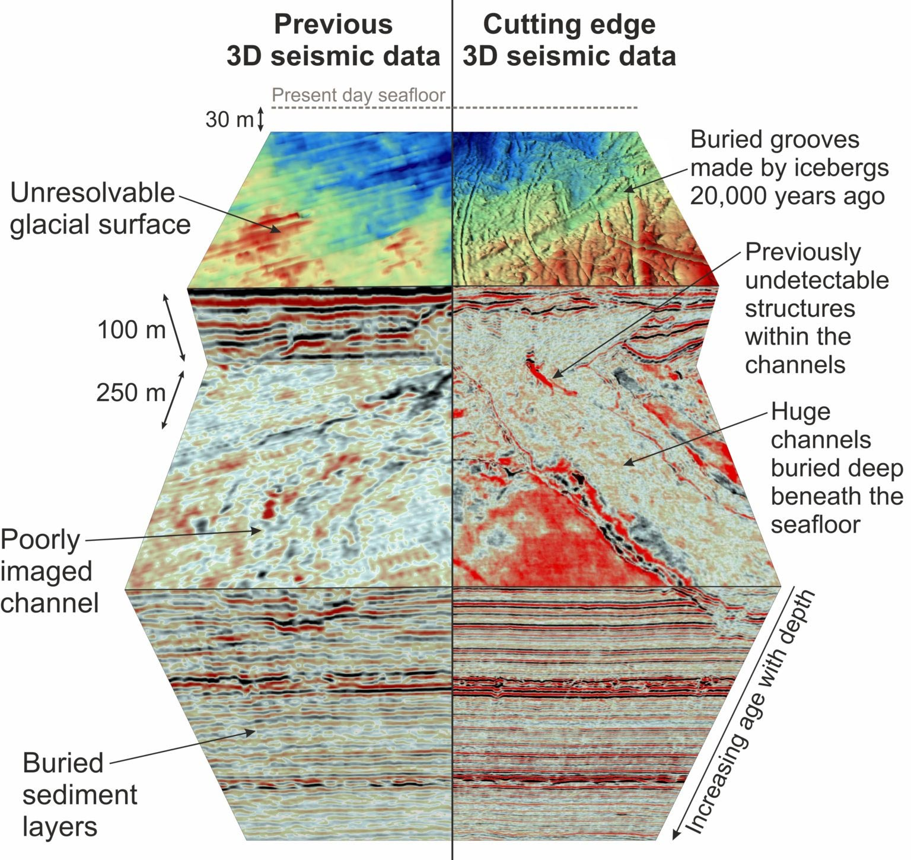
What is seismic reflection data?
Seismic reflection data is the optimal method to produce high-resolution images of the Earth’s crust deeper than 10’s m (can image well to about 10-15 km depth)
Seismic reflection data was the key dataset used in oil and gas exploration
Environmental applications will often combine seismic data with core, gravity, magnetic and resistivity data
2D seismic data provides a cross-section through the Earth
3D seismic data provides a data volume
4D seismic data provides time-lapse 3D data
Kirkham et al. 2021, Geology

Slide 7
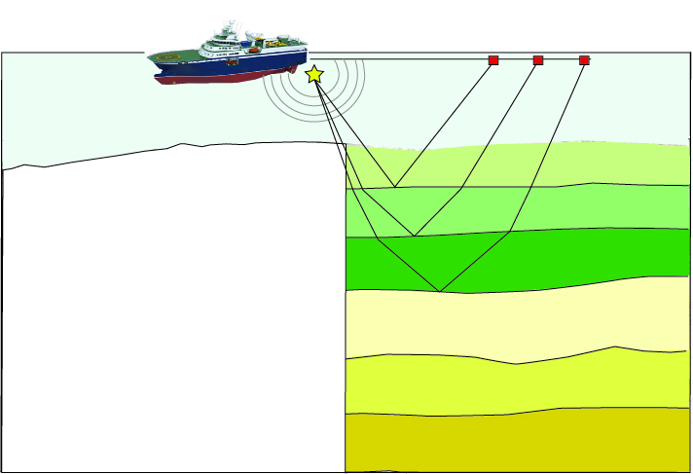
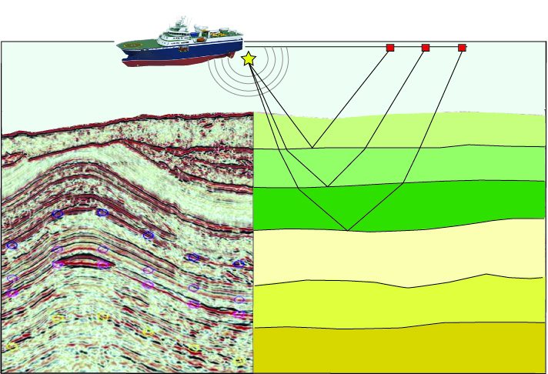
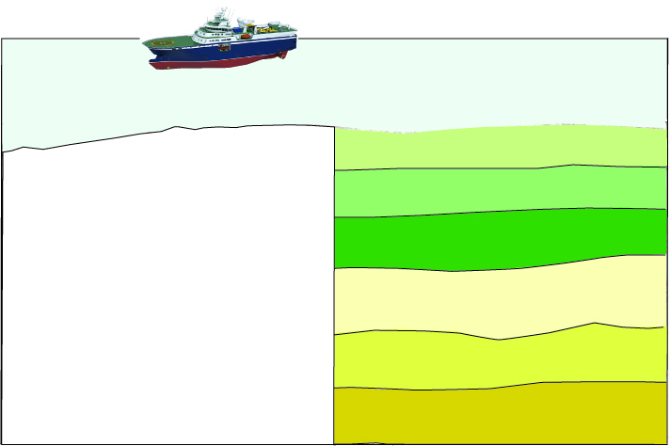
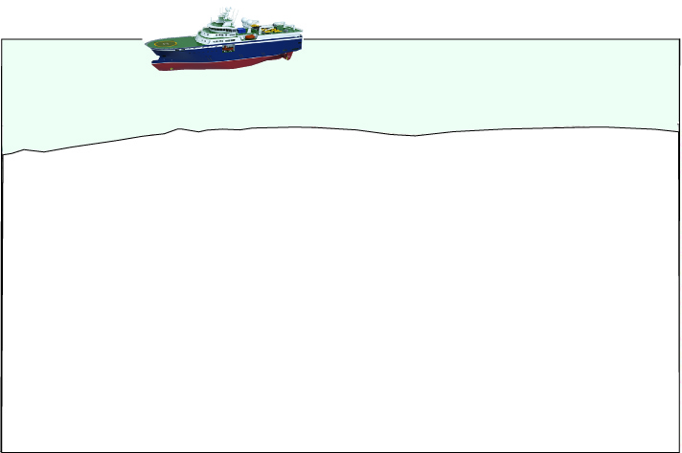
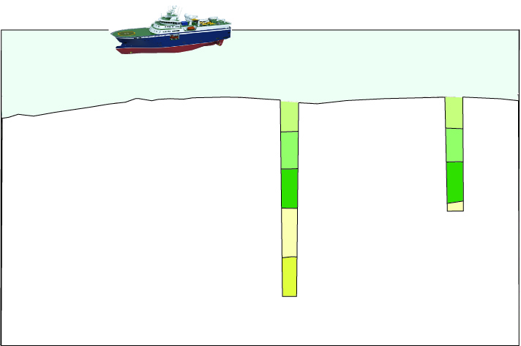
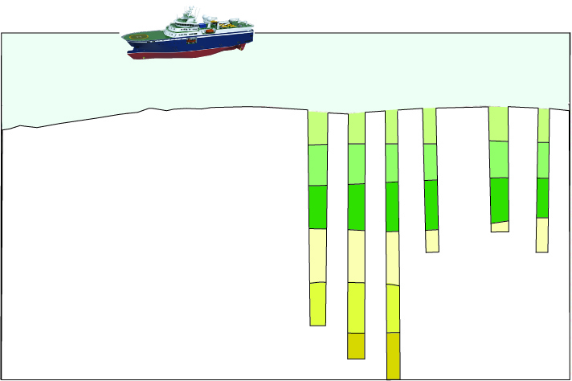
What is seismic reflection data?
Time
Seismic data from the Baram Basin, NW Borneo (http://geoseismic-seasia.blogspot.it)

Slide 8
Why are we learning about it in EDSML?
Seismic interpretation is predominantly done by geoscientists
Historically, seismic is processed and interpreted using proprietary or open-source software (companies are keen to give the software to universities for free). These software are complex ‘black-boxes’
Some countries provide open-access to their seismic data, others provide it through portals for academics/students, sometimes companies will provide students with confidential data with conditions on publications
Traditionally seismic interpretation has been very manual- involves tracing (drawing) seismic horizons and faults
There is now a focus on doing seismic interpretation in a more automated way so i) larger volumes of data can be analysed in a realistic time, ii) the interpretations are less subjective, and iii) multiple interpretations can be produced so uncertainty can be explored. WE NEED DATA SCIENTISTS

Slide 9
Overall learning objectives
1. Understand the common data format for seismic reflection data (SEG-Y)- the primary method for creating high-resolution images of the Earth’s subsurface from 10’s m to km depths
2. Demonstrate technical competency in handling SEG-Y data and identify relevant open-source data repositories
3. Identify and design suitable data analysis strategies for fully-processed seismic reflection data (post-stack attribute analysis). Appreciate the potential for data scientists to revolutionize the field of seismic data analysis
4. Understand the limitation of seismic data and data analysis products. Understand sources of errors and uncertainties, how these are currently dealt with in traditional workflows and appreciate the potential for data science to help better characterise these uncertainties

Slide 10
What we will do in this course:
To reach these objectives and allow you to access, view and analyse seismic data effectively in this course, potential MSc projects or in future job roles we need to cover a substantial amount of background in terms of:
How seismic data is collected and the very basics of how it is processed (Day 1)
The common data format (SEG-Y), how to view seismic data and post-processing methods to better reveal geological/environmental features (Day 2)
We will not be able to cover all aspects of seismic data acquisition, processing and interpretation (this would involve a course many weeks long)- we will just cover the areas needed to give you a good appreciation of the data and allow you to work with the final product- a fully processed seismic data volume in SEGY format
Feel free to ask questions during the lectures or during breaks

Slide 11
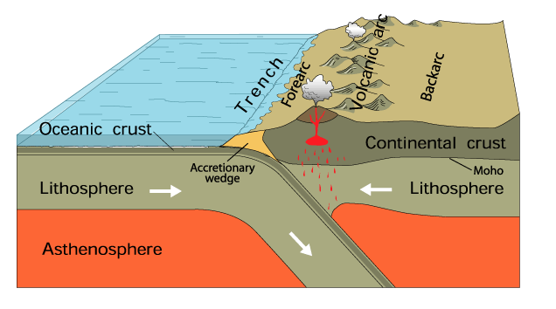
Dr Rebecca (Becky) Bell
Geologist and Geophysicist (not a Data scientist)
I use seismic reflection data to learn about seismic hazard of the largest faults on Earth
Time (s)
https://www.usgs.gov/news/earthword-subduction

Slide 12
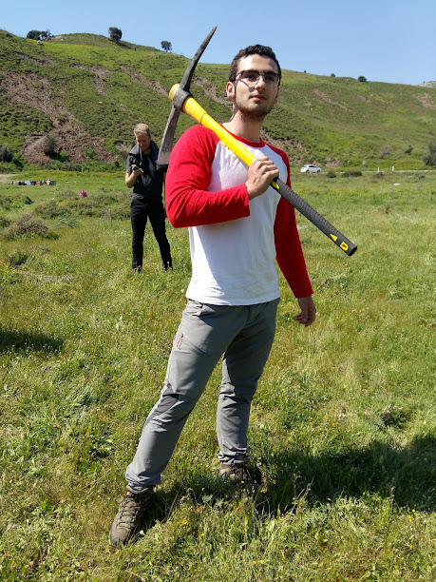
Raul Adriaensen
BSc Geophysics
MSc Applied Computational Science and Engineering
PhD studying coastal change through remote sensing, ML and numerical modelling
Other fields of interest: finance, design
Geophysics fieldwork in Cyprus 2019
Contact details:
Email/teams: raul.adriaensen17@imperial.ac.uk
Linkedin: www.linkedin.com/in/rauladriaensen

Slide 13
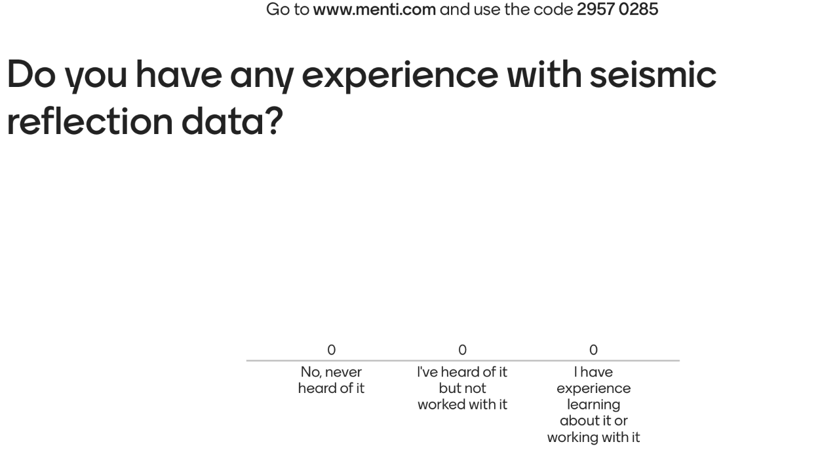
Have you heard of seismic reflection data?

Slide 14
What to expect…
Theoretical lectures (no coding!) in the morning given in ~45 min blocks with 15 min breaks in between
Python exercises in the afternoon, which you can work through at your own pace
The assessment will be on Friday. It will be set at 12 and be collected at 4pm. The assessment is designed to only take you 1-2 hours, but you will have 4 hours to spend if you wish (33% marks for rivers, 67% for seismic)
The assessment will include similar activities to the exercises and some written-answer questions to test understanding in a Jupyter notebook
There is no need to “revise”. The best preparation is to make sure you understand the exercises and ask questions if you don’t understand a concept

Slide 15
Module outline
Day 1 morning- Introduction to seismic data
Lecture 1: Physical principles
Lecture 2: Data acquisition
Lecture 3: Key data processing steps
Day 1 afternoon- Exercises
Exercise 1: Synthetic seismic sections
Exercise 2: Viewing “raw” data gathers and conducting NMO corrections and velocity analysis
We will discuss the “solutions” to the exercises during the afternoon sessions (and these will be recorded)

Slide 16
Module outline
Day 2 morning- Visualising and interpreting seismic data
Lecture 4: The SEGY data convention and where to find data
Lecture 5: How to interpret seismic data
Lecture 6: Seismic attribute analysis and machine learning (future outlook)
Day 2 afternoon- Exercises
Exercise 3: Reading SEGY data and visualizing 3D data
Exercise 4: Calculating seismic attributes
We will discuss the “solutions” to the exercises during the afternoon sessions (and these will be recorded)

Slide 17
Books
Given the short nature of this course you will not have enough time to read textbooks. Don’t worry, all the Info you need to get good marks in the assessment is in the lectures and exercises.
I will provide some links to articles/blogs/journal articles for extra information for those interested.
Key text book for the basics concepts An Introduction to Geophysical Exploration, Kearey, Brooks & Hill. Blackwell Publishing
Key blog: http://www.agilegeoscience.com
17

Slide 18
Lecture outline
Objective of lecture 1:
Review seismic wave propagation and understand the fundamental principles behind the seismic reflection method
1) Background- seismic waves and propagation
2) Acoustic impedance and reflection coefficients
3) The seismic trace
Exercise 1- Synthetic seismic modelling

Slide 19
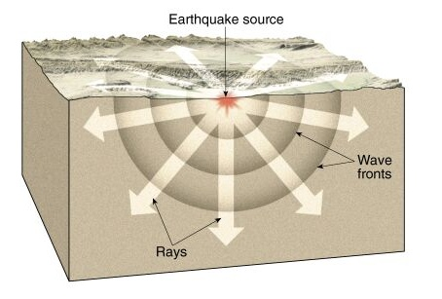
Background- Seismic waves
Seismic waves are “parcels” of elastic strain energy that propagate outwards from a seismic source, e.g. earthquake, explosion or impact
Seismic waves travel spherically from a seismic source, but we often consider their direction of travel as linear “ray paths” which travel 90º to the “wavefronts”
In seismic reflection surveying we detect the seismic waves with recording instrument after they have travelled through the Earth
Impact or explosion
Recording device
http://principles.ou.edu/eq_seismo/seismo_interior_simple.html

Slide 20
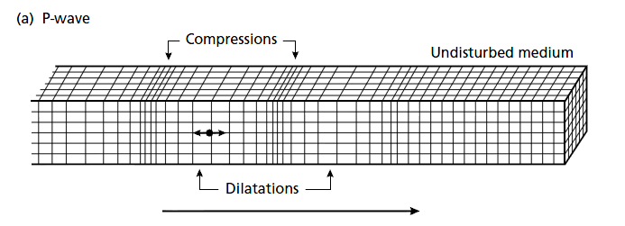
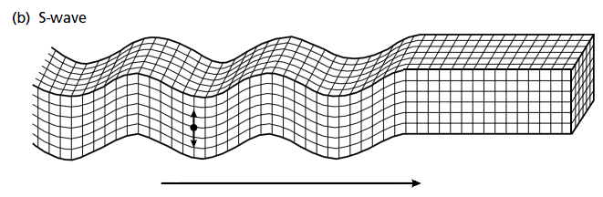
Background- seismic body waves
There are a number of different types of seismic wave, which differ in how they propagate and the particle motion they experience
P (primary) -waves propagate by compression and dilation, with particle motion in the direction of travel (compressional wave)
S (secondary) –waves propagate by pure shear strain in a direction perpendicular to the direction of travel (transverse/shear wave)
P-waves used in seismic reflection
surveying (fastest arrivals)
Bolt 1982

Slide 21
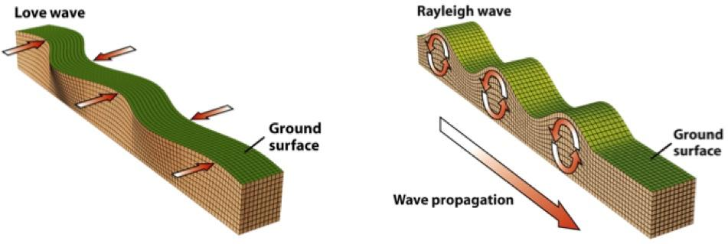
Background- seismic surface waves
In this course we will learn about…
Active source, P-wave, seismic reflection imaging

Slide 22
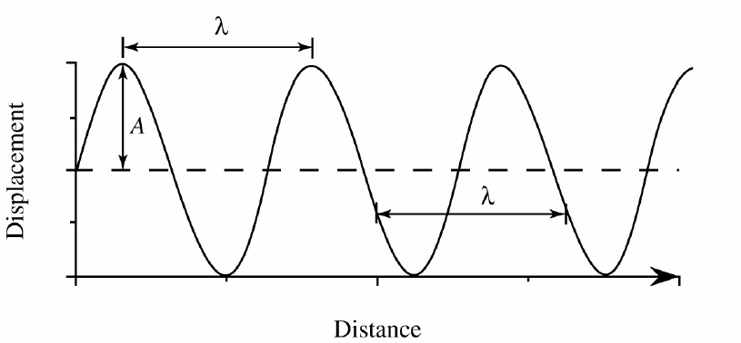
Wave revision
Seismic wavelength (λ) is distance between successive peaks
Seismic velocity = frequency x seismic wavelength (v = fλ)

Slide 23
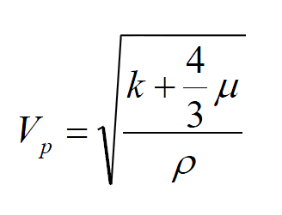
P-wave velocity
Vp = P-wave velocity in a medium
ρ = density of a medium
k = bulk modulus (“incompressibility”-measure of a substance’s
resistance to uniform compression)
μ = shear modulus (“rigidity”- measure of a substances' response
to shearing strains)

Slide 24
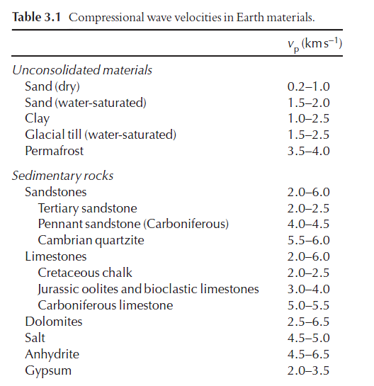
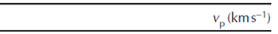
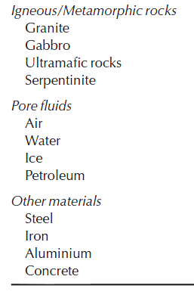
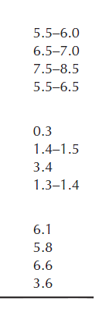
P-wave velocity
Kearey, Brooks & Hill. An introduction to
Geophysical Exploration

Slide 25
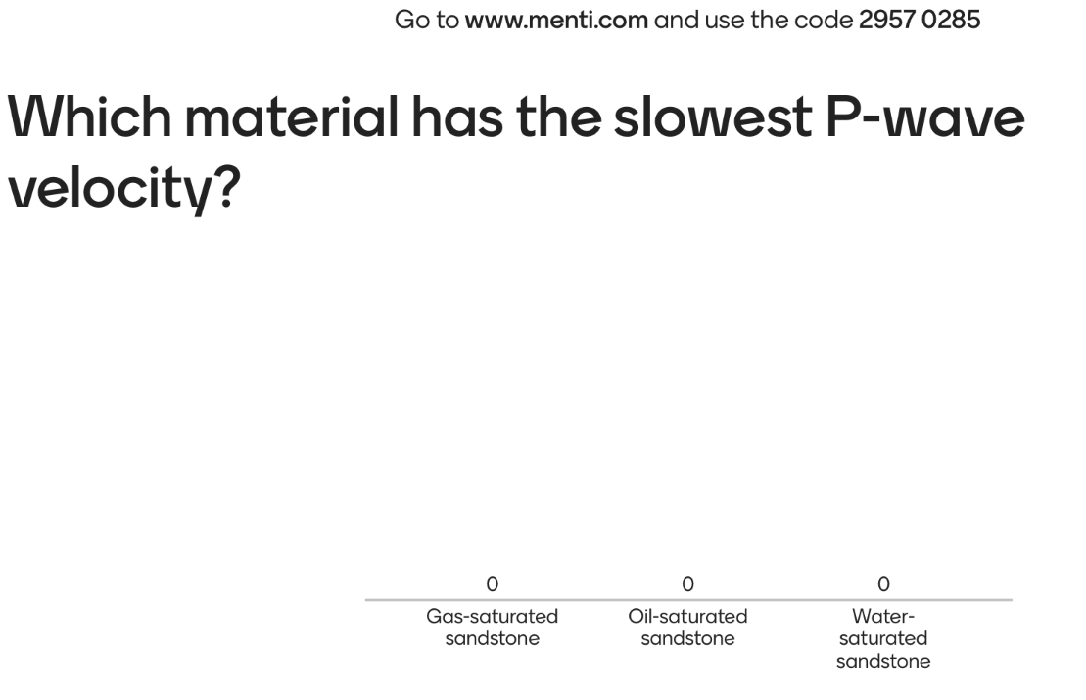


Slide 26
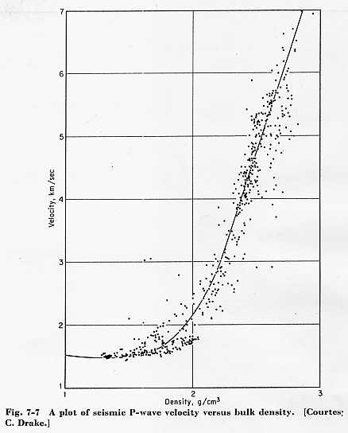
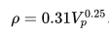
P-wave velocity
Velocity and density are
closely correlated
Nafe-Drake curve
Velocity usually increases with
depth due to compaction. Fractures
close and porosity decreases
Sediments usually have lower
velocities than metamorphic and
igneous rocks
The Gardner relationship is an empirical relationship
Between density and velocity:
Nafe & Drake 1961

Slide 27
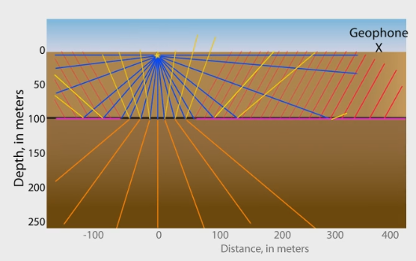
Seismic wave propagation
Seismic waves produced by a source propagate
through the Earth in a number of different ways:
Direct waves (blue): These travel from source to receiver directly
Reflected waves (yellow): These travel from the source, reflect from an interface before being detected at the receiver
Refracted Head waves (pink): These travel from the source, bend at an interface and travel within a deeper layer before being detected at the receiver
Refracted/Transmitted waves (orange): Travel across an interface (they can then later be reflected or refracted)
Seismic wave propagation movie from IRIS (Incorporated Research
Institutions for Seismology)-
https://www.iris.edu/hq/inclass/animation/seismic_wave_behavior_a_single_boundary_refracts__reflects
The reflected waves are key for seismic reflection imaging

Slide 28
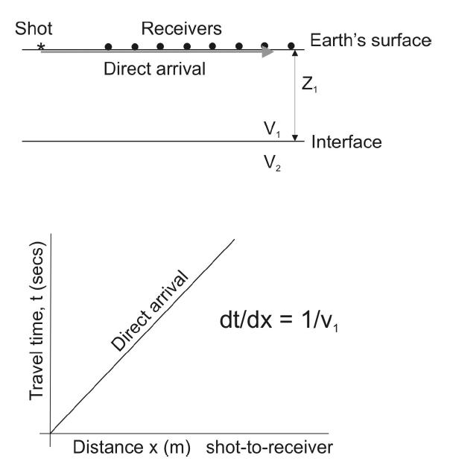
Seismic wave propagation- Direct arrival
100 m
Direct wave/arrival
R1
R8
P-wave travels close to
Surface at velocity v₁
At x=0, t=0
If dt is the time taken to
travel between 2 adjacent
receivers spaced a distance
dx apart then:
dt =dx/V₁
V2>V1
R8
100 m
R1
Velocity = Distance/ Time
Offset

Slide 29
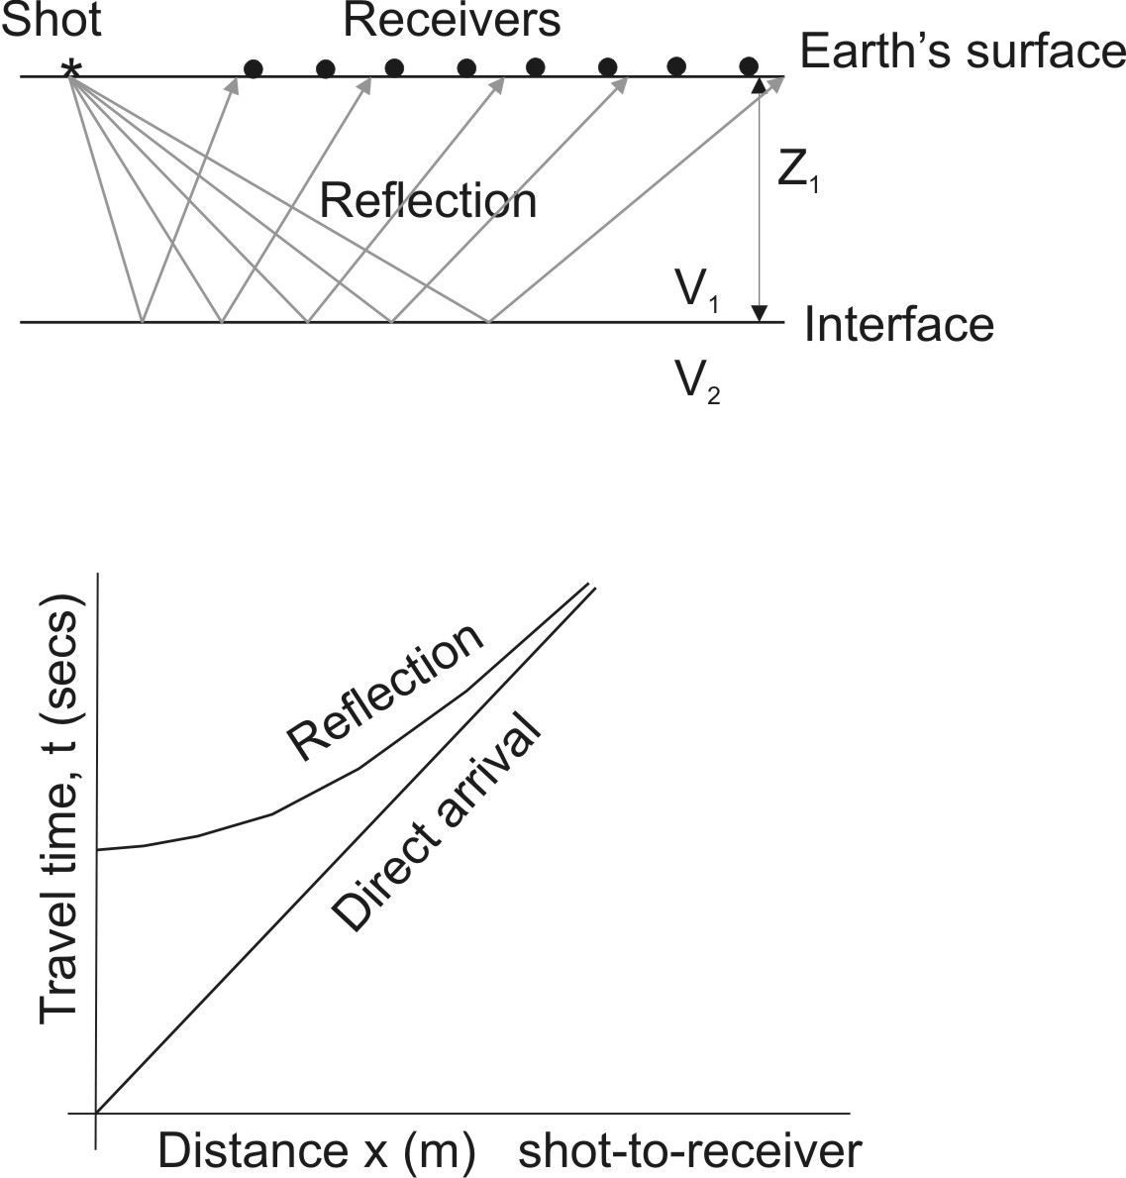
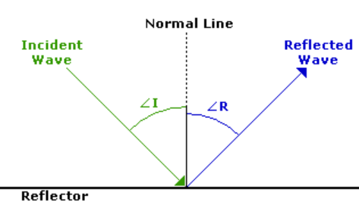
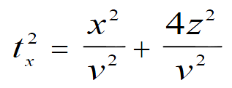
Seismic wave propagation - reflection
Reflected arrival
100 m
Angle of incidence = angle of reflection
R1
R8
V2>V1
Reflection curve is hyperbolic
At x=0, intercept time=2z/v
For large x the reflection arrival
time is approximately equal to
the direct arrival time
R8
100 m
R1

Slide 30
Seismic wave propagation
Reflected arrival
R1
For a “normal incidence” reflection
t=2z/v
V2>V1
t = Two Way Travel Time (TWTT)
R1

Slide 31
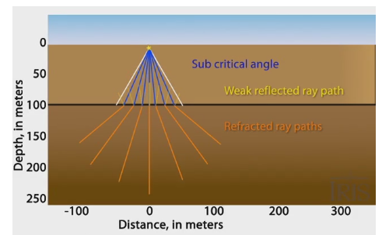
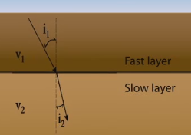
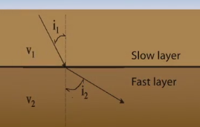

Seismic wave propagation – refraction/transmission
Refracted arrival
Sometimes called
“transmitted arrival”
Snell’s law
$\frac{sini_{1}}{sini_{2}}= \frac{v_{1}}{v_{2}}$
i₁ = angle of incidence, i₂ = angle of refraction

Slide 32
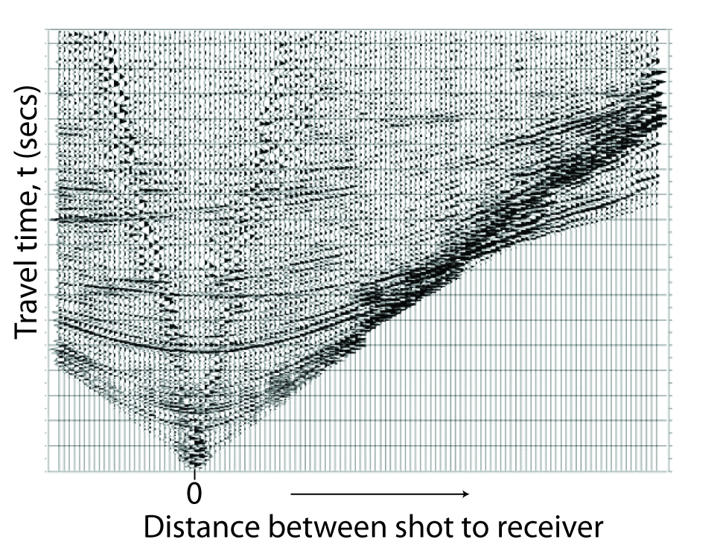
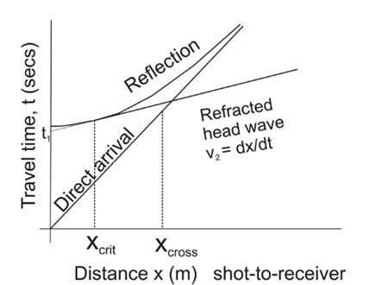
Seismic wave propagation
Shot Gather
Refracted
head wave
Reflection
Direct arrival
Seismic traces from a single shot are grouped together to form a shot gather

Slide 33
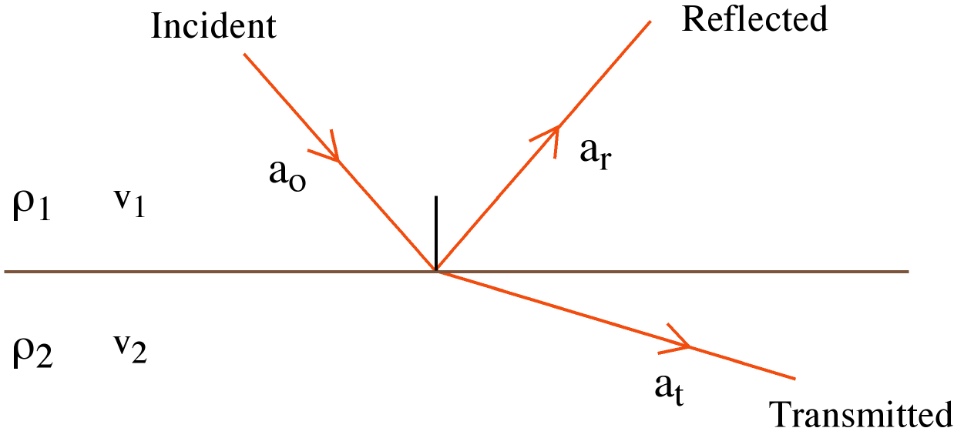
Acoustic impedance
The amount of energy reflected back from each interface is dependent on the Acoustic Impedance (Z) contrast.
The acoustic impedance for a medium is defined as the product of density and P-wave velocity:
Z = ρ x V
The acoustic impedance contrast is the relative impedance change across a boundary.

Slide 34
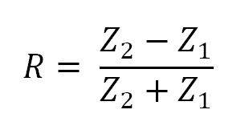
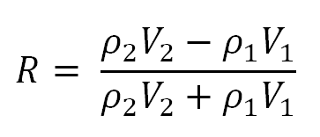
Reflection coefficients
The reflection coefficient “R” or “Rc” is the ratio of the amplitude a_{r} of the
reflected ray to the amplitude a_{o} of the incident ray
R = a_{r}/a_{o}
The reflection coefficient can also be written in terms of the acoustic
impedance across a boundary. For a “normal incidence” ray:
Normal
incidence

Slide 35
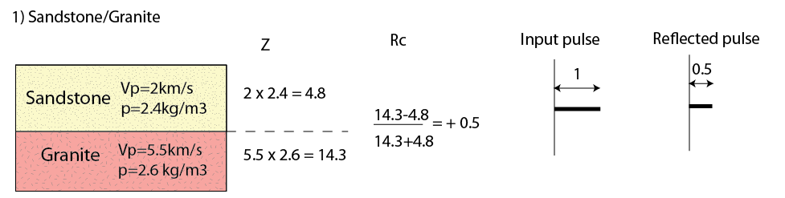
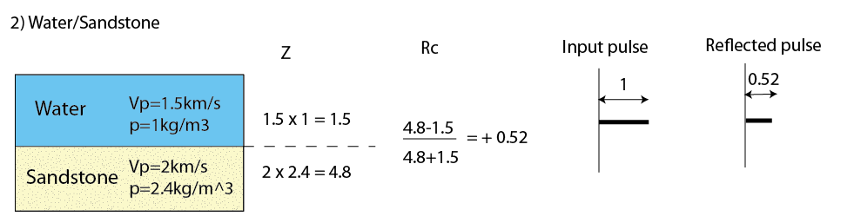
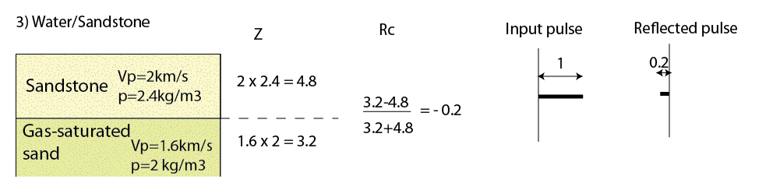
Reflection coefficients

Slide 36
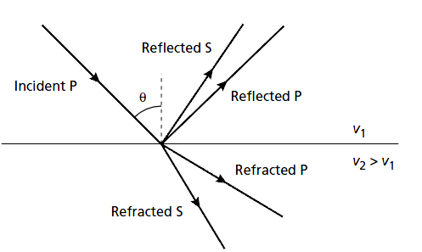
Reflection coefficients
If a P-wave is obliquely incident on an interface with an acoustic impedance contrast, reflected and transmitted P-waves are generated. Additionally, some of the incident compressional energy is converted into reflected and transmitted S-waves.
The amplitudes of the four phases are now a function of the angle of
incidence and the simple Reflection coefficient equation breaks-down
The amplitudes instead can be determined from the more complex Zoeppritz’s equations

Slide 37
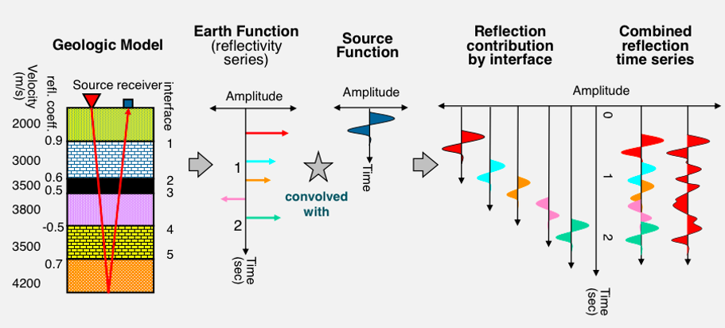
The convolution model of the Earth
Yanghua Wang, pers comm

Slide 38
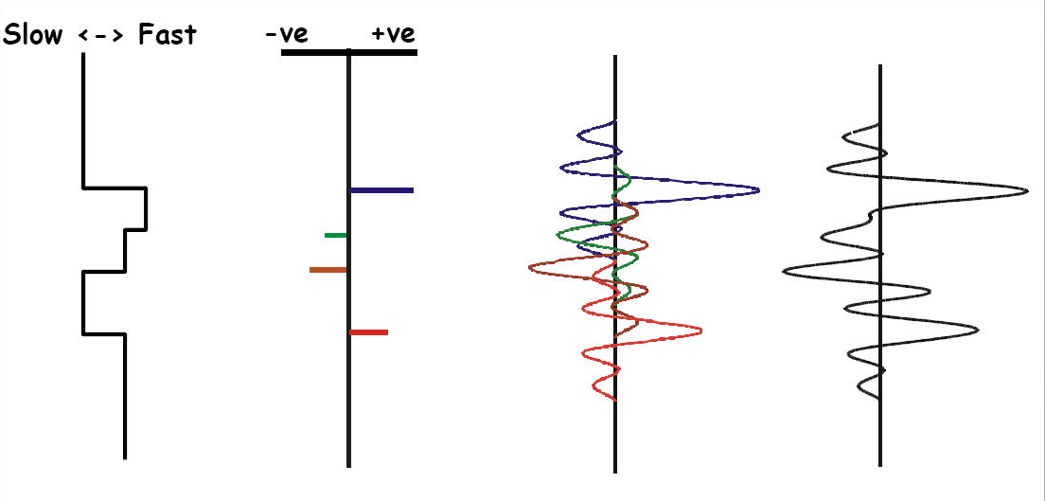
The convolution model of the Earth
Z
Rc
X
For complex wavelets and/or thin geological features the resultant seismic trace could look quite different to the Input reflectivity series- this is a challenge for seismic data Interpreters and a limitation of the method.
We will explore this issue further in Exercise 1
Input pulse

Slide 39

Seismic resolution
Vertical Resolution
Ability to recognise individual, closely spaced reflectors (minimum thickness a feature can be to image the top and bottom separately)
Maximum resolution is ~¼ of the dominant wavelength of the pulse
(Rayleigh Criterion)
+
v₃ > v₂ > v₁
You will explore
this for yourself
in Exercise 1
+
Sheriff & Geldart, 1995

Slide 40

Earth as a low-pass filter
Seismic wavefields traveling through the Earth lose amplitude due to a process called attenuation.
Attenuation acts on the seismic wavefield in 2 ways:
1) The amplitude of the wavefront decays with increasing distance (r) from the source proportional to 1/r (Geometric Spreading)
2) Absorption and scattering cause higher frequency components to be lost more readily, so the input pulse lengthens as it propagates.
Therefore, as seismic waves travel deeper their
frequency content lowers and we become unable
to resolve small features
Bush & Garossino, 1993

Slide 41



Introduction to Exercise 1: Synthetic modelling
What would a geological feature look like in seismic reflection data?
Unit C (SST)
Unit 3 (MTD)
Unit B (SST)
~ 25 m
Unit 2 (MTD)
Unit A (SST)
Unit 1 (MTD)
Cerro Toro and Tres Pasos formations, Cretaceous, southern Chile
Armitage & Stright 2009

Slide 42



Introduction to Exercise 1: Synthetic modelling
Synthetic seismic reflection profiles at varying frequencies (A-120 Hz; B-60 Hz; C-30 Hz; D-15Hz)
Note decreasing seismic resolution at decreasing seismic frequencies

Slide 43
Ideas for Data Scientists
Synthetic models like these could be used for training in deep learning to teach algorithms what various geological features look like
- can synthetic training data be as useful as labels provided from real seismic data?
-can synthetic models provide training data for global seismic volumes (ie no need for location specific training data)?

Slide 44
Introduction to Exercise 1: Synthetic modelling
In this exercise you will explore how:
Seismic velocity, density and thickness of geological feature affect the resulting 2D seismic section
Explore how different wavelets affect the look of the seismic data- what is the “ideal” wavelet we should be using?
What is the thinnest geological feature we can resolve with a seismic wavelength of λ?

Slide 45
Learning outcomes
You should now be able to…
Appreciate why seismic reflection data is important/useful
Understand the fundamental method (we will learn more about this later…)
Understand that seismic traces are the result of convolution between the
reflectivity series and a source wavelet
Thanks to: Yanghua Wang, Jenny Collier, Lidia Lonergan, Jo Morgan from Imperial College London, Chris Jackson from
the University of Manchester and Mark Vardy from SAND Geophysics for contributing material for this lecture series

